Slide 1

Research Methodologies
Presenter: Lindelweyizizwe Manqele

Slide 2
Research Methodology
A suitable approach to solve the identified problem
Reviewed, viable based on theory (Literature review)
Know the generic steps
Customize the generic steps based on the identified problem
Search for suitable dataset
Identified metrics to measure the performance

Slide 3
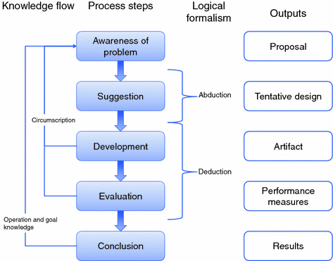
Design Science Research Methodology (DSRM)

Slide 4
Examples of research methods
Machine learning
Natural Processing Languages (NLP)
Artificial Intelligence
Recommender Systems
Encryption
Design Science Research (DSR)

Slide 5
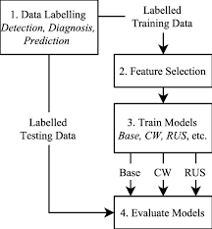
Machine Learning

Slide 6
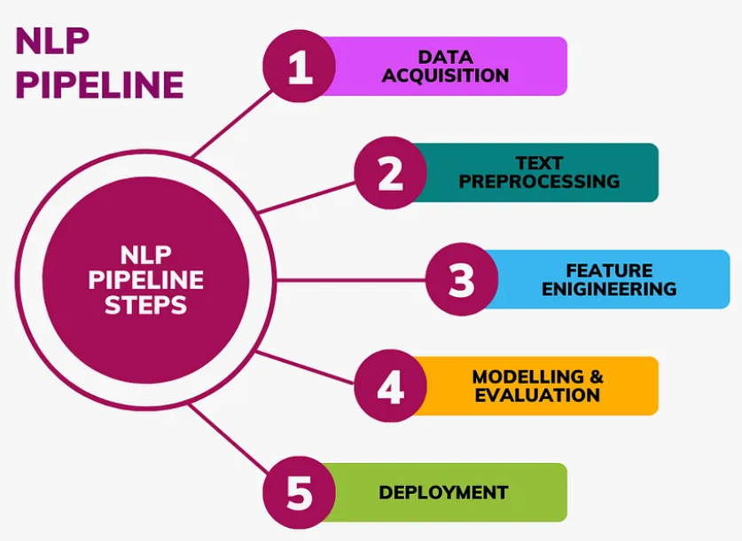
NLP

Slide 7
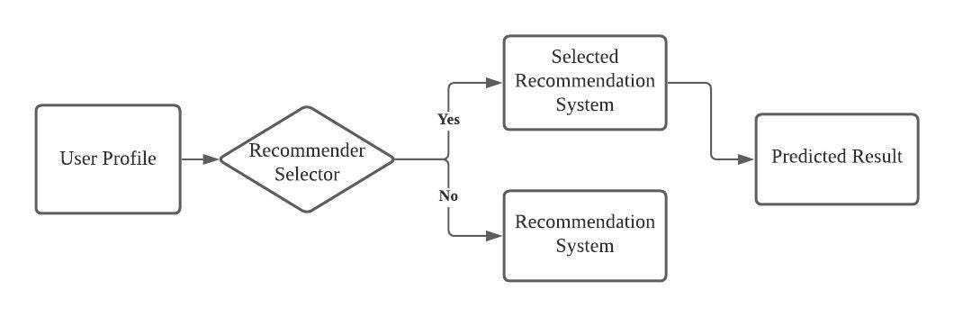
Recommender Systems

Slide 9
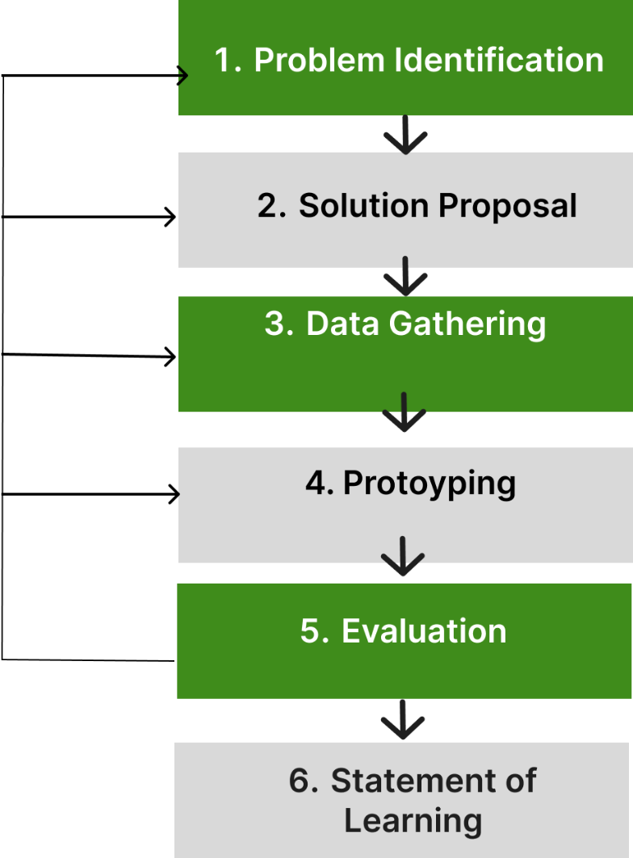
Research Methodology
A Design Science Research Methodology (DSRM) is used to improve an existing system for measuring so moisture levels. This study will integrate a web application for farmers to analyze historical and current soil moisture data easily.
As depicted in Figure 1, this approach aims to ensure that our system is effective and user-friendly, contributing to better water management and improved agricultural productivity.
Figure 1: Design Research Process

Slide 10
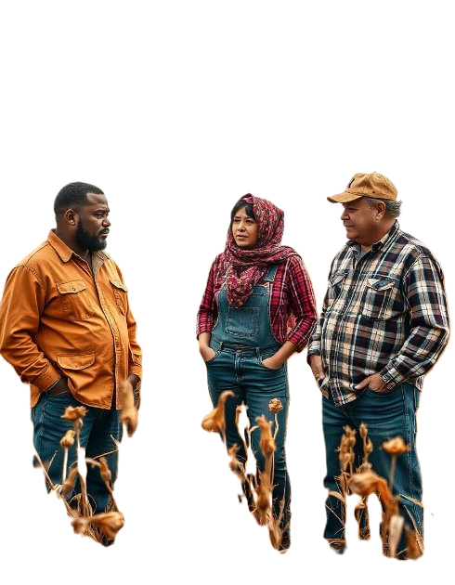

Research Methodology cont…
Rural farmers face challenges because of lack of resources, limited knowledge, and the high costs of advanced technology. These technologies can help with irrigation and detecting soil moisture. However, they need to be more affordable and easier to use.
1/6: Problem identification

Slide 11
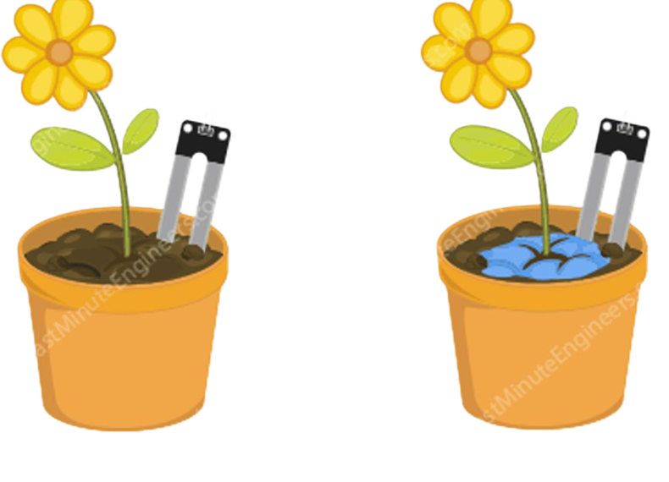
Research Methodology cont…
Cost-effective and informative IoT Fog-based prototype.
This prototype will analyze, detect and monitor data received from sensors.
Engage information on the steps that the farmer needs to follow to enhance irrigation through chatbot.
2/6: Proposed Solution

Slide 12
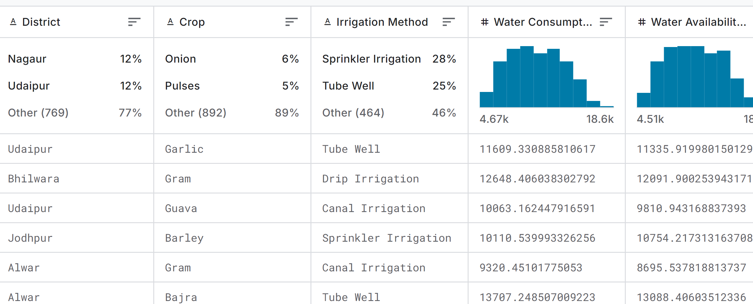
Research Methodology cont…​
​
Existing datasets are freely accessible and sourced from educational, investigative, and rural organizations. Figure 2 , examines the impact of various irrigation methods on crop production
DataSample:water_usage_data [Agricultural Data for Rajasthan, India (2018-2019) (kaggle.com)] ​​
Data Size: 553.5 KB ​​
Records: 769 records​
Repository: Kaggle
URL: Agricultural Data for Rajasthan, India (2018-2019)
3/6: Data Gathering
Figure 2: Summary of Water Usage from different Irrigation systems

Slide 13
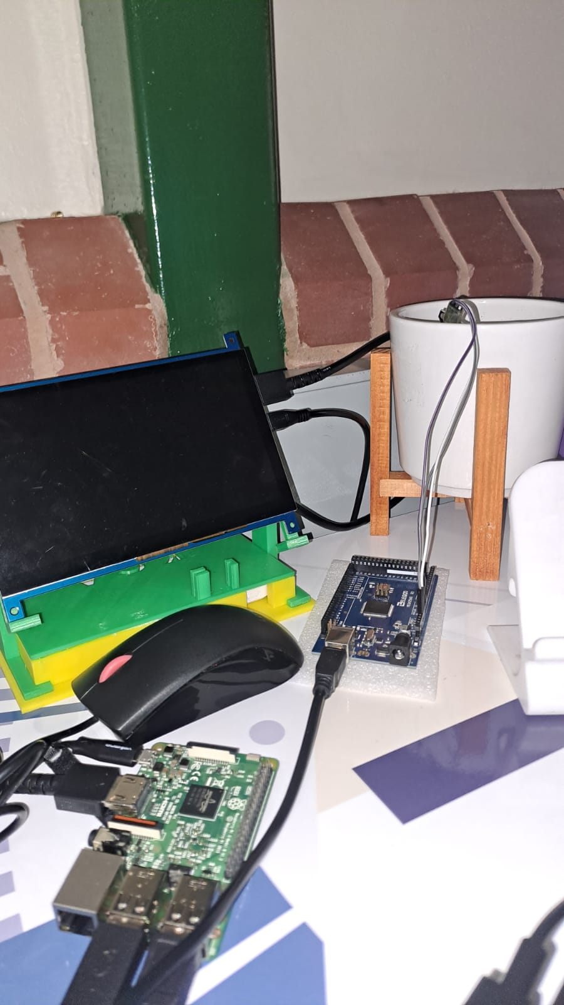
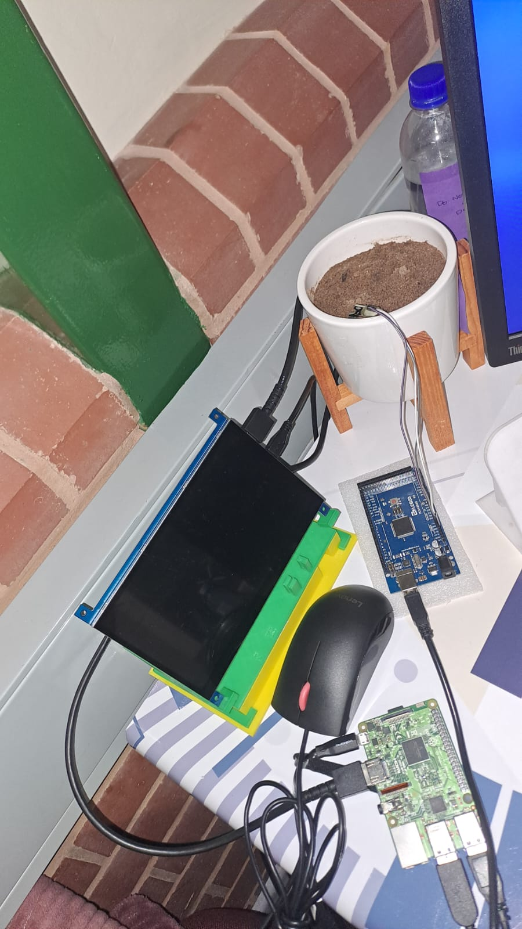
Research Methodology cont…
Prototyping is the core phase that guides us through fully developing the system's UI/UX design and the proposed solution. Design and Development Technology Stack:
Front end: Python
Backend: Html, CSS, JavaScript
Database: SQLite
Framework: Flask
Sensors: Soil moisture sensor
SBC: Arduino Mega and Raspberry Pi 3
4/6: Prototyping

Slide 14
Research Methodology cont…
Data analysis
Processing and visualizing real-time sensor data on soil moisture to generate actionable recommendations for optimizing irrigation.
Visualization: Create charts and graphs to visualize soil conditions, trends, irrigation patterns, and trend analysis to validate the system's effectiveness and accuracy.
Evaluation: Benchmarking
Underscores the significant value the proposed system can provide, particularly for small-scale farmers, due to its combination of advanced technology and cost-effectiveness
Cost-effectiveness by analyzing the system's implementation costs against financial benefits.
Usability will be assessed through farmer feedback on usability and effectiveness.
Informative will be evaluated by tracking increases in productivity resulting from optimized irrigation.
5/6: Evaluation

Slide 15
Research Methodology cont…
Statement of Learning
Dashboard: Soil moisture
Chatbot: Informative interaction
Graphs ( Dashboard ): Cost effectiveness
6/6: Statement of Learning

Slide 16
Enkosi
SIYABONGA
Re a leboga
धन्यवाद Dhan'yavāda

